Slide 1



E-LEARNING
Tania Mulc mag.paed.
Rijeka, 20th July 2023.

Slide 2

What is
E-learning?

Slide 3

Term E-learning is offten mixed with distance learning;
There is no unique definition!
Depends on focus:
  Accent on technology?
  Accent on process of learning and teaching?

Slide 4
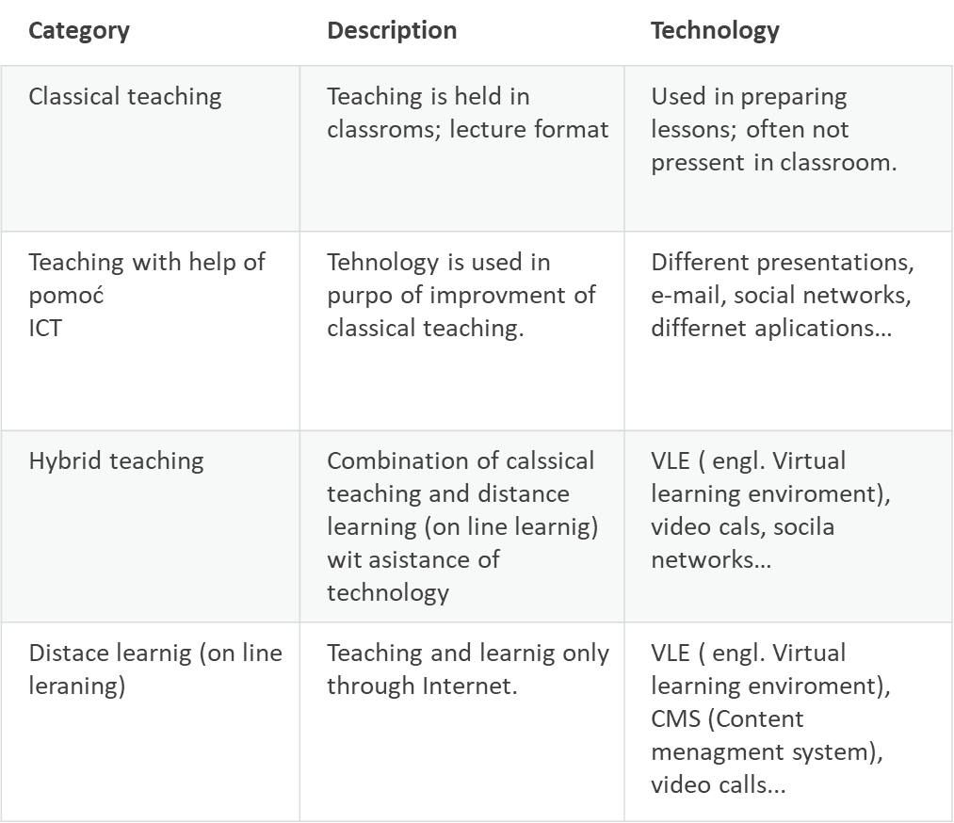
Different deffinitions of E-learning we can caterogized towards level of technology usage:
Technology is used in purpose of improving classical teaching.
Combination of classical learning (on-line learning) with assistance of technology.
Distance learning (on-line learning)
Teaching an learning only through Internet

Slide 5

When did all started?

Slide 6
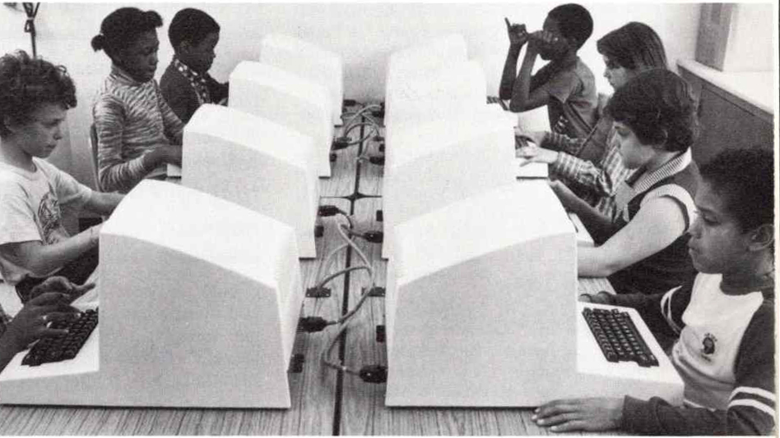
When did all started?
Term E-learning came to life in year 1999.;
In that period learning materials started to have digital form;
- it was cheaper than printing
- accessibility
- eco awernes!
In year 2000., work trainings for eployees;
Some researchers consider that e-leraning started long before, with development of computers;
  – in 1984. computer trainings were available on flip flops;
  - In 1960. Plato program was developed for students from Illinois University;

Slide 7
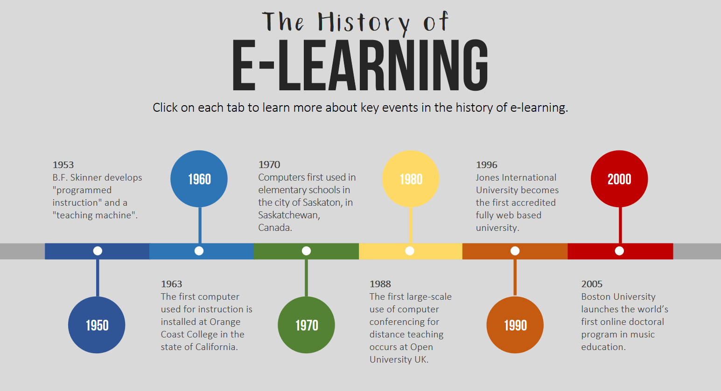

Slide 8
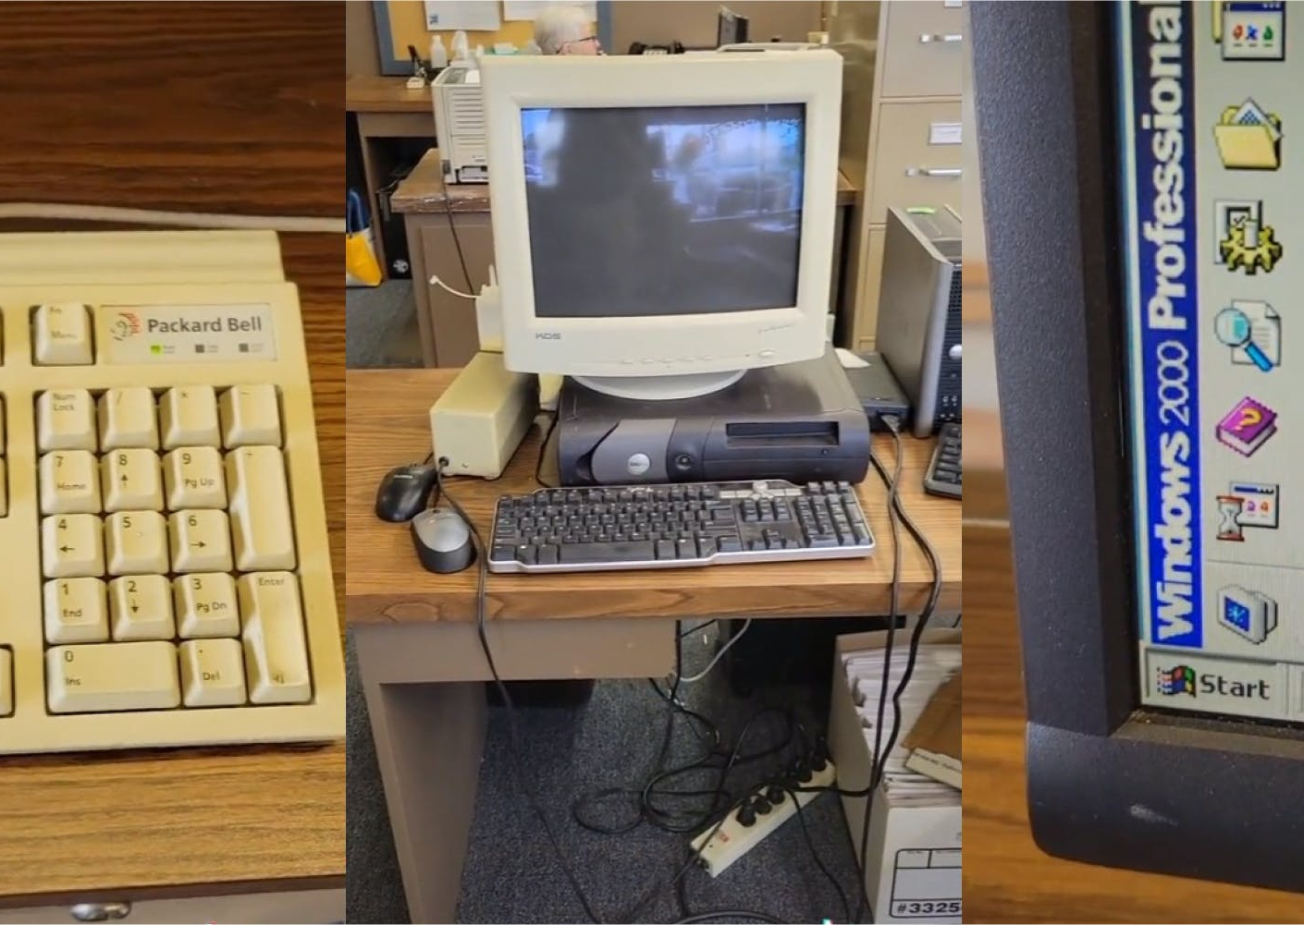
Idea of distance learning strated before Internet even existed;
In 1840. proffesor Pitman teached their students through letters;
  Different taskas, learning materials, research materials were delivered to students via post office;

Slide 9

Does e-learning need planning?
Like every traditional teching, even e-learning needs planning;
Before we start we need to think about following questions:
1. Who is our target group?
2. What will be our outcome ?
3. Which metods and forms of learning we will use?
4. How we will design our e-leraning ?
5. How we will measure our outcome?

Slide 10

Who is our target group?
We need to know with who we will be working;
Do they like individual or group learning?
Do they need leading, or they can control their personal learning?
Are they advanced user or basic user in technology?
Do they have possibility of technology usage?
Do they like to work with technology?

Slide 11

What will be our outcome?
Which competences we want that our target group earn;
-general competences: addition and subtraction, past tens, writing letter in word…
- professional competences: programing, fixing car engine…
Defining our outcome!
They have to be measurable and specific!

Slide 12
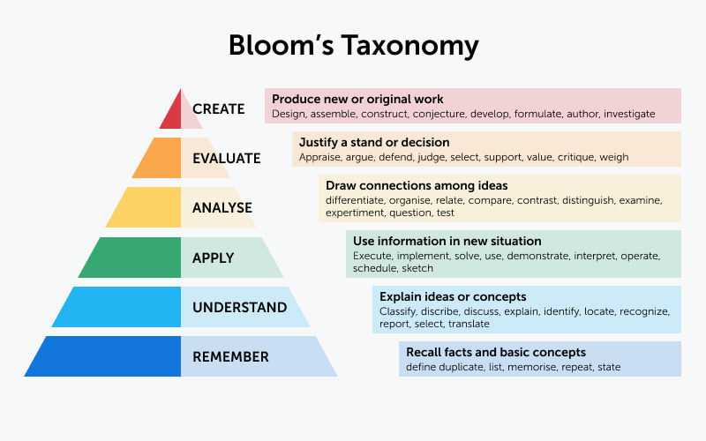
Bloom taxonomy: Most used teorethycal frame for planning, preparation and evaluation!
Example: Student will be able to comapare animal and plant cell.

Slide 13
Which metods and forms we will use?
Metods and forms depends on target groups and outcome we want;
Hybrid teaching or
on line learnign?
More or les apps, videos, social netowrks….
We can use warious methods: demonstration, illustration, practice work, work on text, individual research…
Individual or group work?
How wil we comunicate: through e-mail, blogs, social networks….
Will we use educational platforms for exaple: Microsoft teams..

Slide 14

How we will design our e-leraning ?
When we solve all questions above we can make design scenario.
In education we use official forms but they can be adjusted, so can be used in other fileds ( ex. Culture)
We need to eleborate every part of our lesson
  Who does what, which page in book, how long task will take…
How we will measure our outcome?
Will we be using it on the end of the lesson?
Will it be in form of test or a quiz?
Which form will be more usefull on our number of students?

Slide 15
1.
Preparation faze- number of studensta, their characteristics, pre-kowledeg they need,…
2.
Defining outcome
3.
Description of activities, their order
4.
List of apps and all resurses we will need.
5.
Describing methods and forms
6.
Speciffying time
7.
Planing online and offline contents
8.
Evaluation

Slide 16

E-learning platforms
E-learning effected development of different platforms;
At the beging lot of platforms weren`t primally devoleped for education (ex. Social networks);
Platforms enable accessibility of education;
More eco-frendlly;
Much cheapher;
They are flexible and they enable adaptation to needs of individual;

Slide 17

Independet tools:
- they help us to create quality materials which are transportable in virtual enviroment ( text documets, videos and audio materials, illustartions ect.)
- ex. Microsoft office, Audacity…
Social networks:
- they can be used for comunication
- they conect students, you can share experience, ideas..
- we can use them for presenting student work, video lesons…
- need to be carefull: protecion of student information, cyberbullying
- ex. Facebook, Twiter…
- eTwinning- network developed for education system in Europe

Slide 18

Virtual enviroment:
- different sofftwers developed for education system that gives us closed community and different possibilities;
- in Croatia: Loomen; available to all teachers;

Slide 19
How to choose platofrm?
Most popular model for selection is called SECTION:
1. STUDENTS
2. EASE OF USE
3. COSTS
4. TEACHING AND LEARNING
5. INTERACITVITY
6. ORGANISATIONAL ISSUES
7. NOVELTY
8. SPEED

Slide 20

What are positive and negative sides of E-leraning?

Slide 21
Positive sides
Availability- students are not bound to certain place;
Lot of different tools- makes learning more fun and creative;
Provides differnet types of learning materials (ex. Videos, audio, illustrations…)what makes better quality lessons;
You have possibility to create your own tempo of learning;
Conects different student communities;
Sharing ideas, experinces etc. is much easier;
Provides equality in education- E-leraning can satisfy indivdual needs of every student;
Satisfy needs of bussines world for differnet skills, competnece etc.

Slide 22
Negative sides
Students and teachers need certain skills and IT kowledge (useles for someone who doesn`t have at least basic IT skills);
You need certain IT equipment- unfortunatly not all children have computers at home;
Internet availability
Quality equpiment- technical problems can effect quality of lessons;
Responsibility- all students can`t „control” their learning: to much freedom can affect execution of tasks;
Copyright abuse
Health problems- wrong siting position can cause back problems; lot of screen can effect eysight;
Social deprivation – alimination from society.

Slide 23

Future of E-leraning
Consclusion
E-learning is here to stay with us no matter of its positive and negative sides.
With its accessibility and technology development we can predict progress in E-learning.
Maybe one day whole education system will be implemented in virtual world.

Slide 24
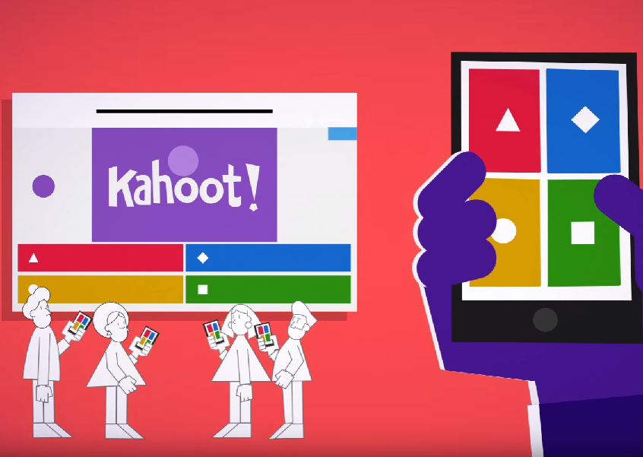
Quiz TIME
kahhot.it

Slide 25

Thank you for
your attention!

Slide 26
References
Čukušić, M., Jadrić, M. (2012). E-učenje: koncept i primjena. Školska knjiga, Zagreb.
Reynolds, K. A. (2002).Going the distance with distance learning: An analysis of motivational factors that influence e-learning course completion rates, Thesis, Air Force Institute of Technology, Ohio.
Mohorić, T., Smojver –Ažić, S., Močibib, M. (2021) Učestalost korištenja IKT-a kod nastavnika i učenika. U Uvođenje suvremenih tehnologija u učenje i poučavanje : istraživanje učinaka pilot-projekta eŠkole. UNIRi, Rijeka. Preuzeto 16.06.2023. sa http://repository.ffri.uniri.hr/islandora/object/ffri:2652/datastream/FILE0/download
Delić Hederić, M. (2021). PRIMJENA INFORMACIJSKO-KOMUNIKACIJSKE TEHNOLOGIJE U OBRAZOVANJU. Sveučilište Josipa Jurja Strossmayera u Osijeku, Ekonomski fakultet u Osijeku
Mikša, M. (2011). Elektroničko učenje u budućnosti. Sveučilište u Zagrebu, Fakultet organizacije i inofrmatike, Varaždin. Preuzeto 16.06.2023. sa https://www.bib.irb.hr/972856/download/972856.elektroniko_uenje_u_budunosti.pdf
Edulab. Što je e-učenje i koje su njegove prednosti. https://edulab.hr/sto-je-e-ucenjee-learning-i-koje-su-njegove-prednosti/
E-leraning: concepts, trends, aplications (2014). San Francisco. California, USA. Preuzeto 28.06.2023. sa https://www.talentlms.com/old/wp-content/uploads/2018/09/elearning-101-concept-trends-applications.pdf

Slide 27
https://egolms.com/zasto-e-ucenje-hr.html
Jandrić, P.; Krčelić, D. i Hazl, V. (2015). Priručnik za osposobljavanje trenera u primjeni i provedbi programa e-učenja i kombiniranog učenja. Zagreb: Hrvatski zavod za zapošljavanje.
http://www.skolskidnevnik.net/2013/02/drustvene-mreze-u-nastavi/
file:///C:/Users/Tania/Downloads/R9-Postajeme-ucitelj_FINAL.pdf
https://scarfedigitalsandbox.teach.educ.ubc.ca/sections-model-assessing-technologies-in-the-classroom/
Bates A. W, Poole G. (2003). Effective Teaching in Higher Education. (str. 47-53). San Francisco: Jossey-Bass.
Delić Hederić, M. (2021). PRIMJENA INFORMACIJSKO-KOMUNIKACIJSKE TEHNOLOGIJE U OBRAZOVANJU. Sveučilište Josipa Jurja Strossmayera u Osijeku, Ekonomski fakultet u Osijeku
Mališa, N. (2022). Suvremene nastavne metode. Sveučilište u Rijeci, Filozofski fakultet u Rijeci, Odsjek za pedagogiju. Rijeka. Preuzeto 17.05.2023. sa file:///C:/Users/Korisnik/Downloads/malisa_natalija_zavrsni_rad_snm.pdf
E-učitelj – suvremena nastava uz pomoć tehnologije (2016). Hrvatska akademska i istraživačka mreža – CARNet. Zagreb. Preuzeto 10. svibnja 2023. godine sa https://pilot.e-skole.hr/wp-content/uploads/2016/12/Prirucnik_e-Ucitelj.pdf?fbclid=IwAR3bcoZGi3jFyixONq9lBc2PnBp4O-T_k1O2A4Agat_MpXl9zE5fnz0clmg
Sveučilište u Zagrebu (2007). Strategija e-učenja 2007. – 2010. Preuzeto 10.svibanj 2023. sa: http://www.unizg.hr/fileadmin/rektorat/Studiji_studiranje/Studiji/e-ucenje/eucenje_strategija/Sveuciliste_u_Zagrebu_Strategija_e_ucenja_Senat_v1.pdf.
Jandrić, P. (2015). Digitalno učenje. Zagreb: Školske novine i Tehničko veleučilište u Zagrebu.
Bucci, W. i Murphy, S. (2015). Multiple Code Theory. Preuzeto 15.svibnja 2023. sa: http://www.thereferentialprocess.org/theory/multiple-code-theory.
Jandrić, P. i Livazović, G. (2013). Priručnik iz e-obrazovanja za osobe treće životne dobi. Osijek: Medicinska škola Osijek. Preuzeto 15.svibnja 2023. sa: http://ss-medicinska-os.skole.hr/upload/ss-medicinska-os/images/static3/1236/File/Prirucnik_P__Jandric_i_G__Livazovic.pdf
Lončar-Vicković, S. i Dolaček-Alduk, Z. (2009). Ishodi učenja: priručnik za sveučilišne nastavnike. Osijek: Sveučilište Josipa Jurja Strossmayera. Preuzeto 10. svibnja 2023. sa: http://www.unios.hr/uploads/49ishodi%20ucenja_prirucnik.pdf
Paić, G., Bošnjak, Ž., Čulina, B., Grgić, N. (2021) Udžbenik za 8. razred: Matematički izazovi 8: Alfa: Zagreb.
KURIKULUM NASTAVNOG PREDMETA HRVATSKI JEZIK ZA OSNOVNE ŠKOLE I GIMNAZIJE (2019.). Ministarstvo znanosti i obrazovanja, Zagreb.
KURIKULUM ZA MEĐUPREDMETNU TEMU GRAĐANSKI ODGOJ I OBRAZOVANJE ZA OSNOVNE I SREDNJE ŠKOLE (2019). Ministarstvo zanosnosti i obrazovanja, Zagreb.
Nimac, E. (2011.) Primjena Bloomove taksonomije znanja u nastavi. Zagreb. Preuzeto 20. svibanj 2023. godine sa https://www.azoo.hr/app/uploads/uvezeno/images/razno/E._Nimac.doc

